Slide 1



fITpRO iNC -angular project
By
- M Prakash Rajan

Slide 2
Problem statement
User Flow:
We have to implement a routed user interface with multiple pages
1.Page containing Search for Food Products and Their nutritional Value
2.Page Displaying Dietary Plans and Benefits
3.Building a Dietary Plan and Findind the nutritional Benefits
4.Pages to communicate with platform to ask suggestion and get Responses
5.Forum page
Admin Flow:
1.We Can Add Products
2.We Can Respond to Suggestions Asked

Slide 3
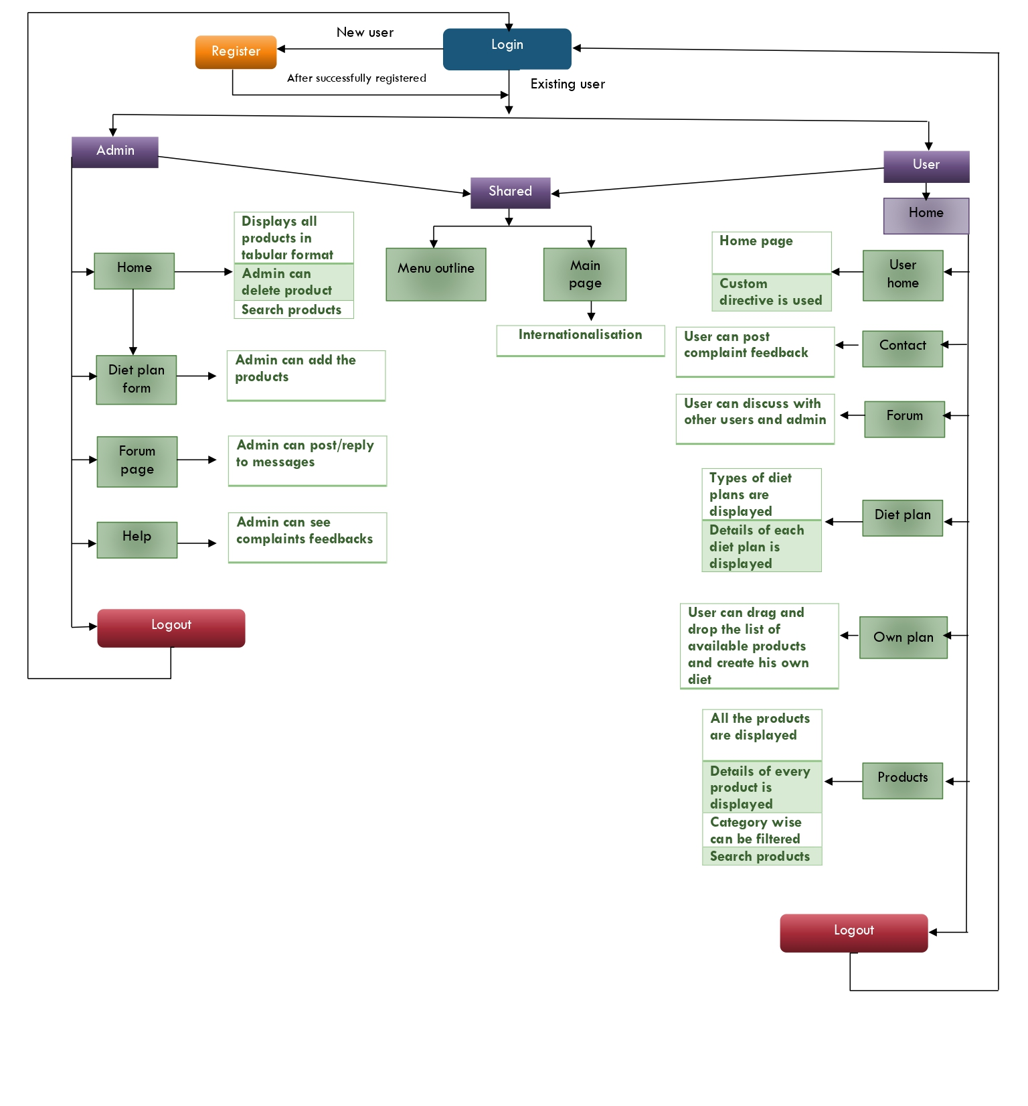
Project Work flow

Slide 4
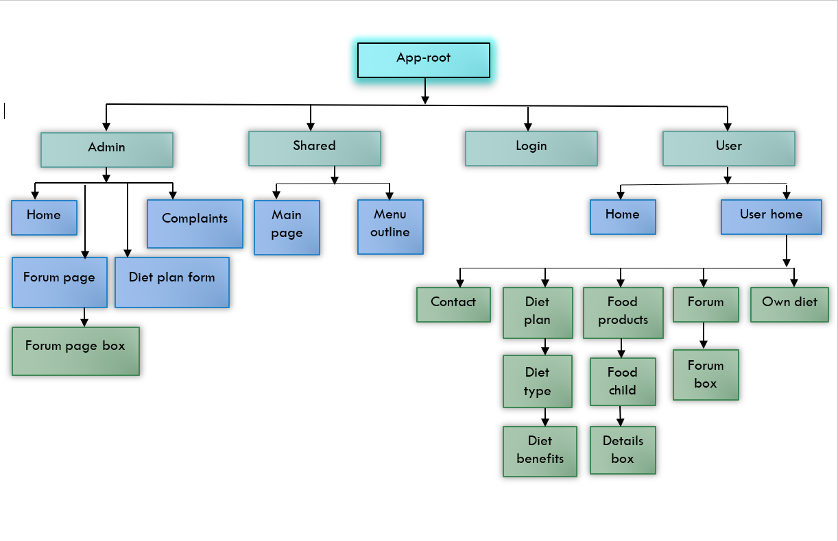
Components workflow

Slide 5
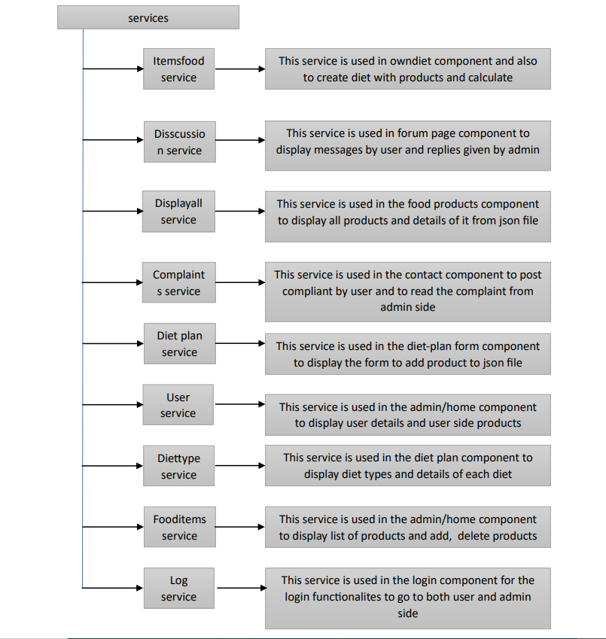
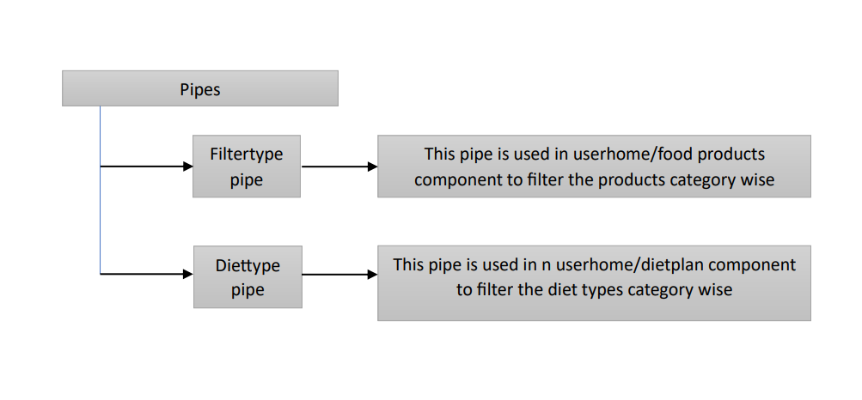
Services & pipes workflow
Services workflow
Pipes workflow

Slide 6

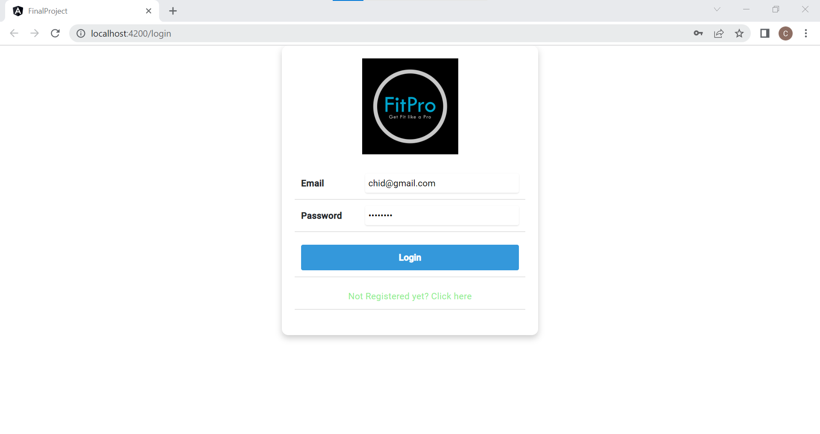
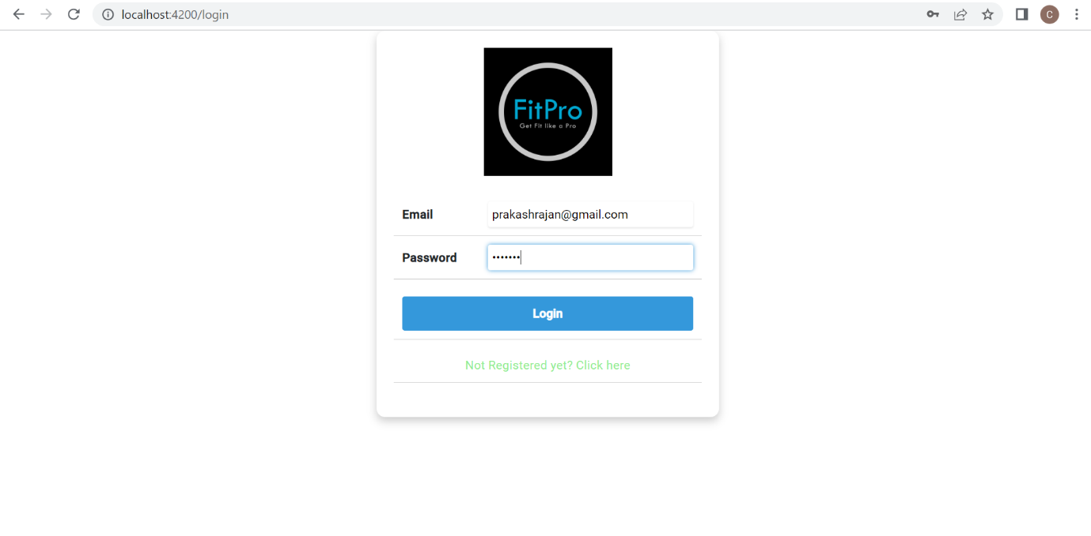
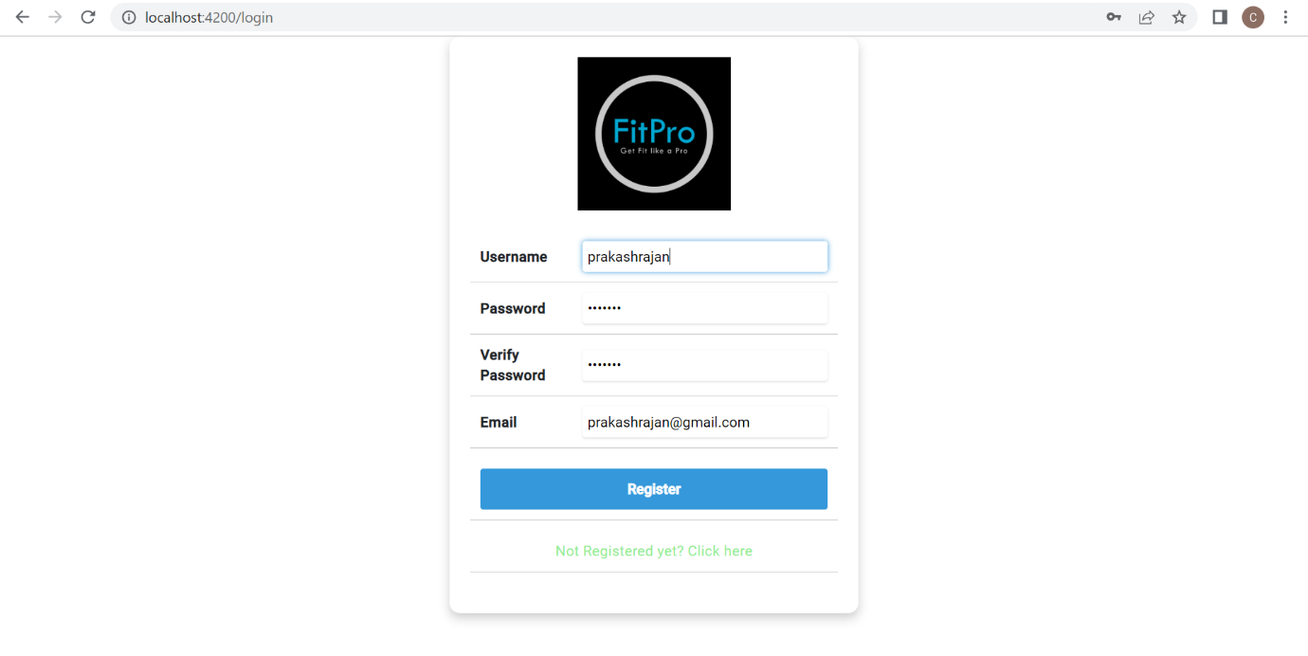
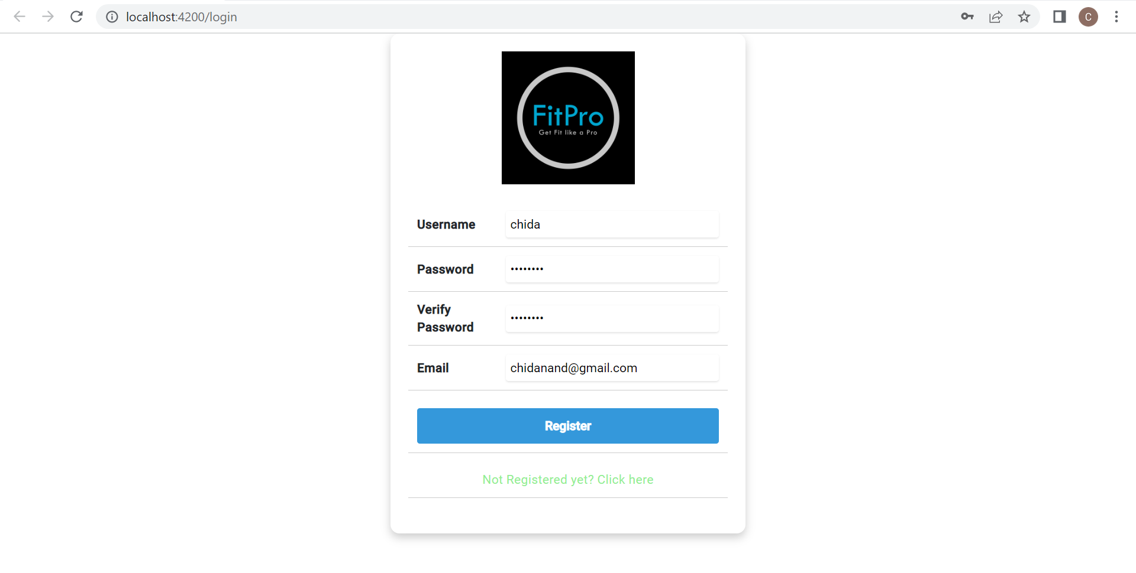
Login page and signup Page
Here is the login page where we can register if we are new user
If you are already registered then you can login with the user credentials
If you want to login as admin you need to
Change type from user to admin in json file
Validation is also implemented.

Slide 7
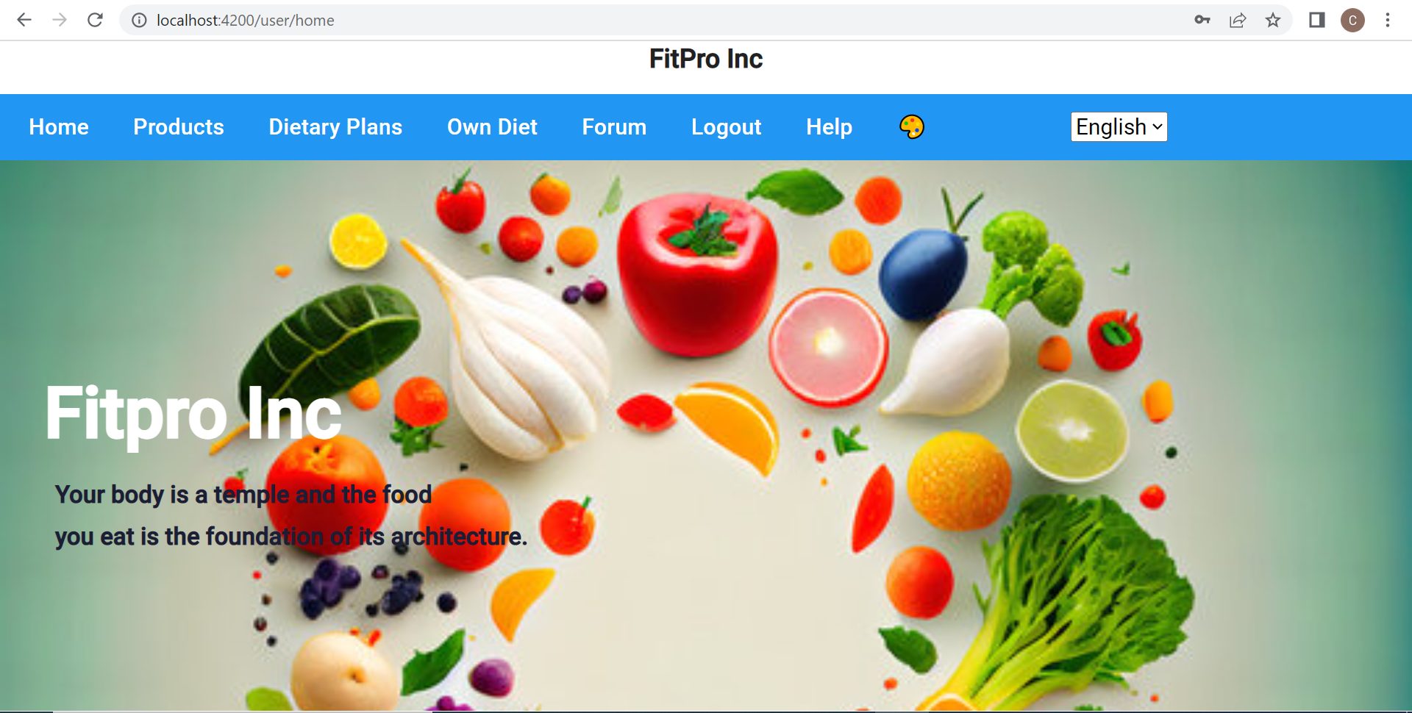
User homepage
After logging in as user this homepage will appear
this homepage consists of components such as products ,dietary plans ,own diet ,forum logout option , complaints to be raised and theme changer and menubar translation

Slide 8
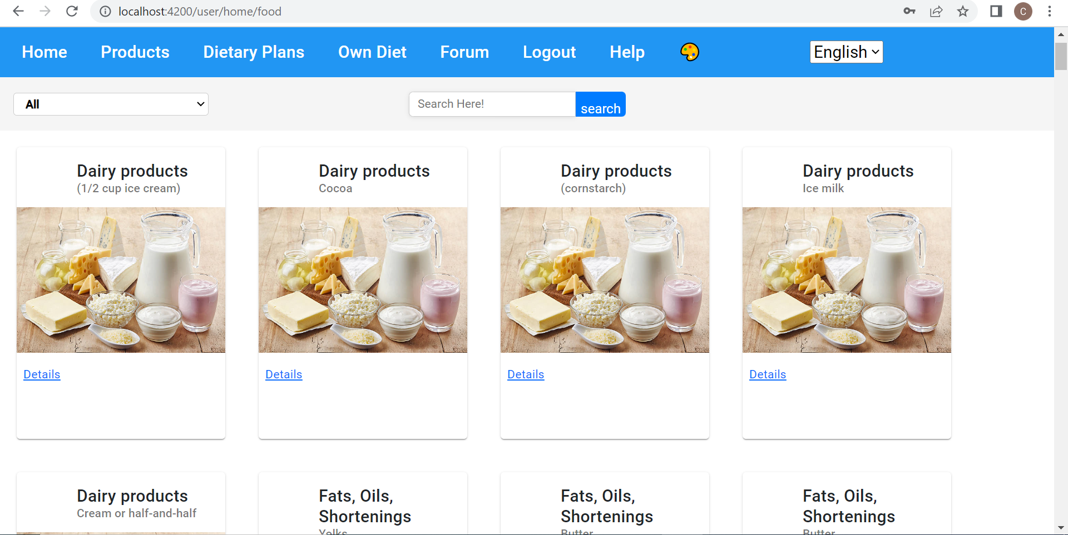
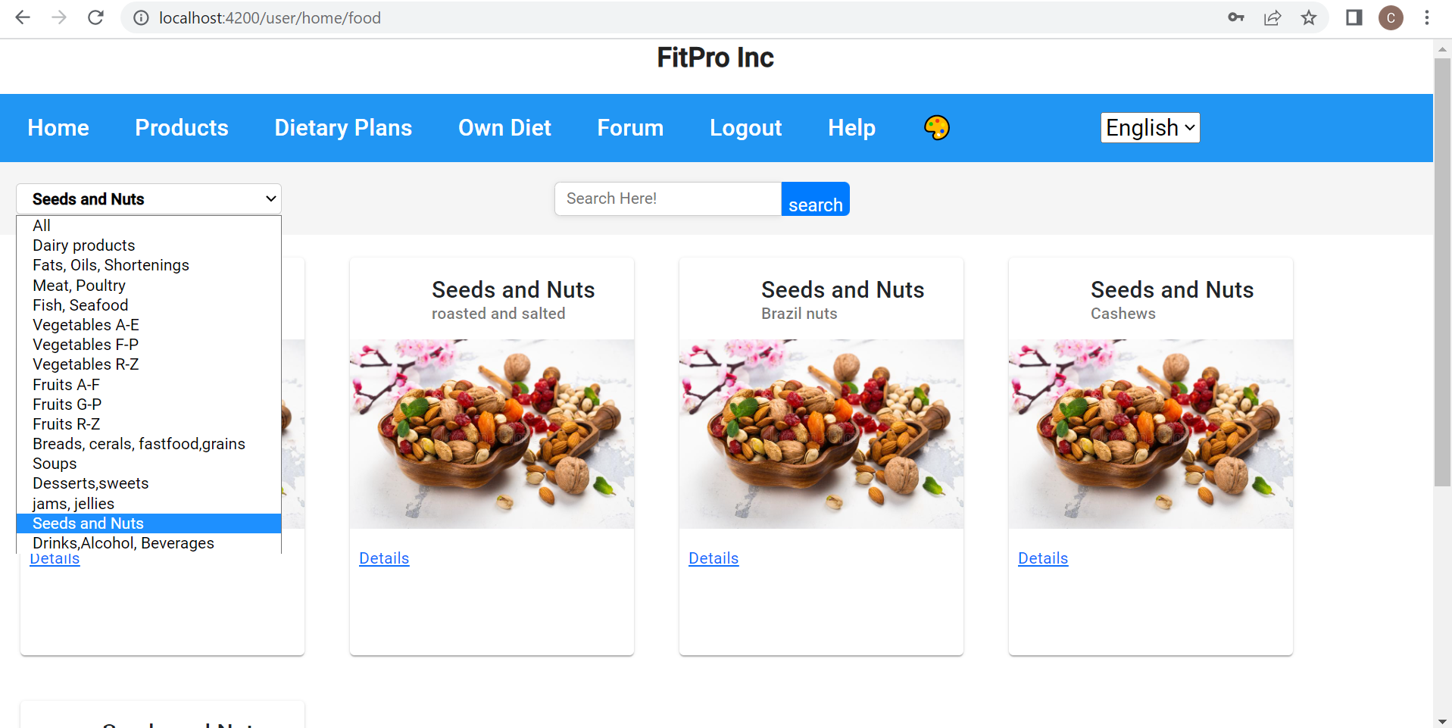
Userside food products
homepage menu bar consists of products after clicking on that we get a products like all displayed in a page which is connected with routing
We have used pipes for filtering that category wise
we can also search whatever we required like particular product

Slide 9
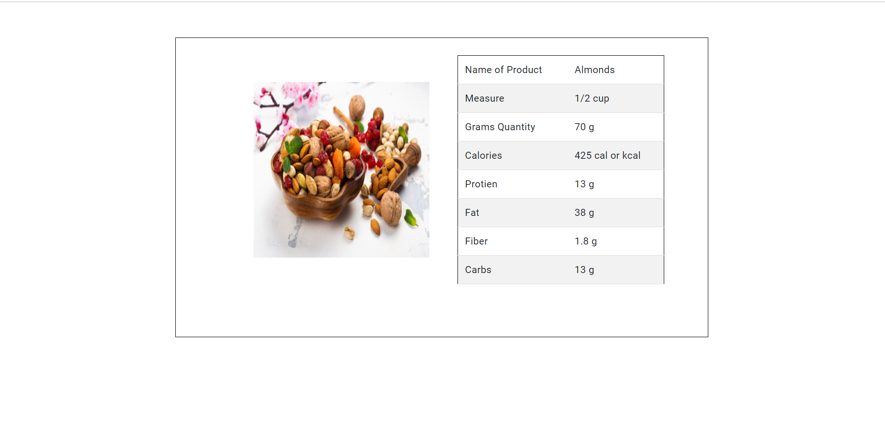
Userside food products details
in the products page the products are displayed under which under each and every product there is a details option
after clicking on to that details button it takes to new page through routing where details of particular product is displayed

Slide 10
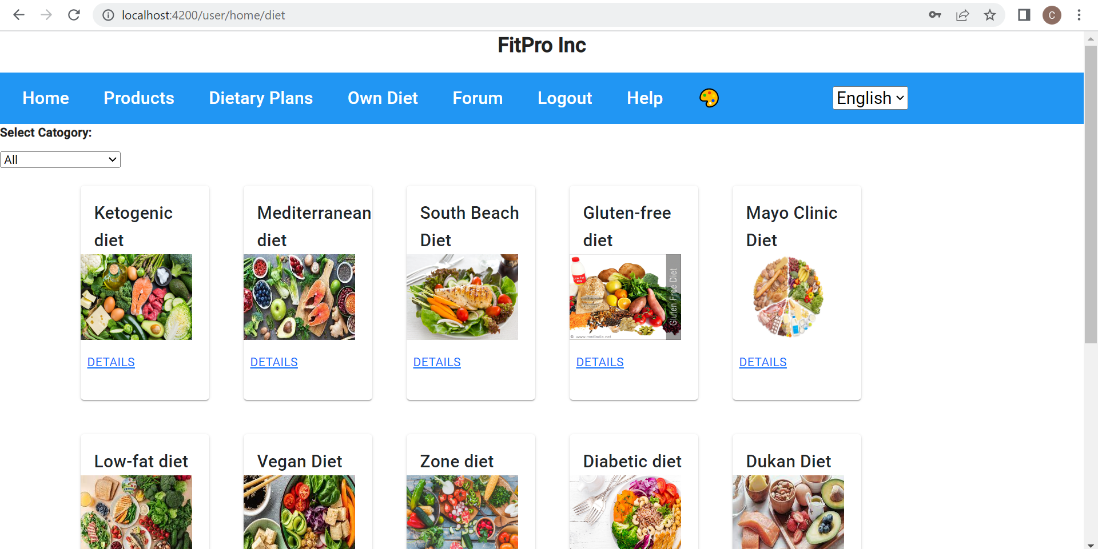
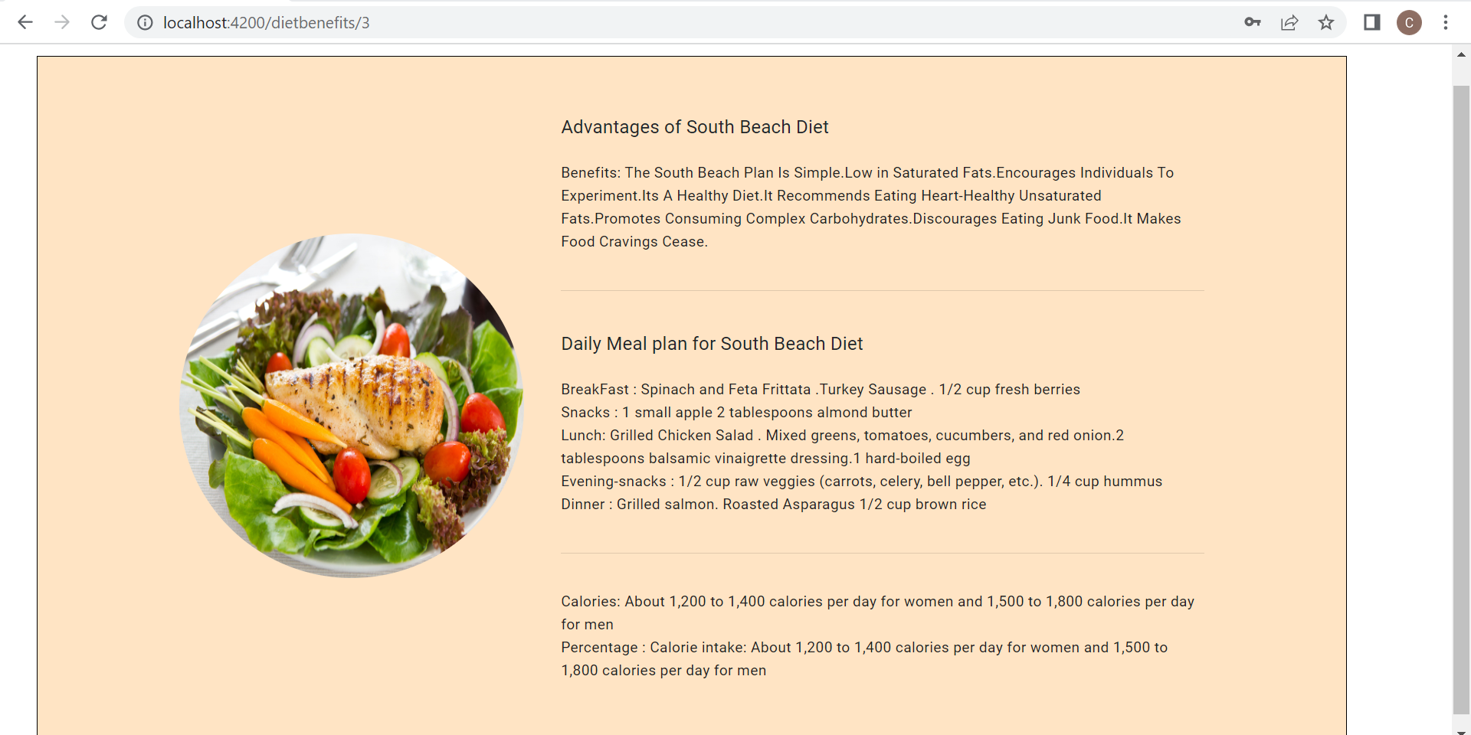
Userside dietary plans
In home page after clicking on detail plans there is a page displayed news different types of diets are provided
On clicking details we get the details of each and every diet in which advantages of particular diet and diet meal is included

Slide 11
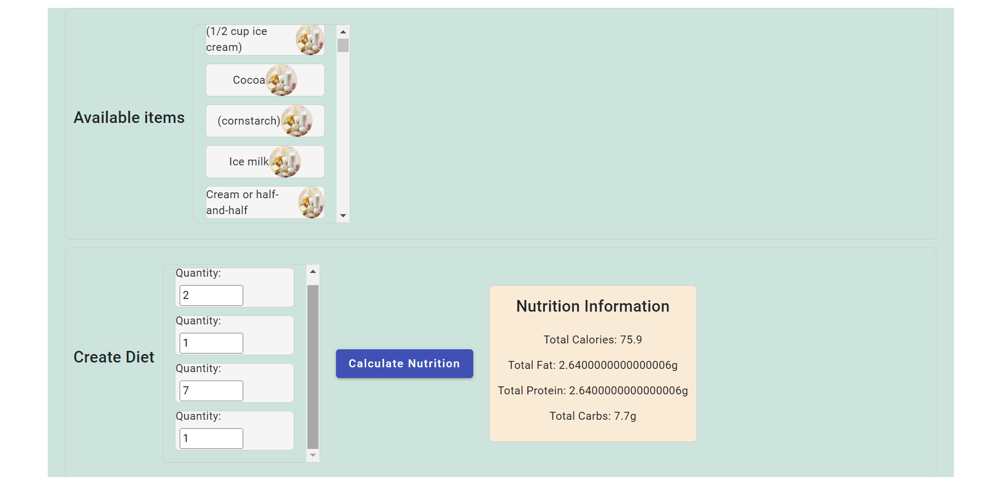
Userside create diet
This page a user can create his own diet by using drag and drop option
there is a list of products displayed he can drag and drop to the place where quantity is calculated
after quantity is decided he can click on the calculate nutrition button it calculates the nutrition value

Slide 12
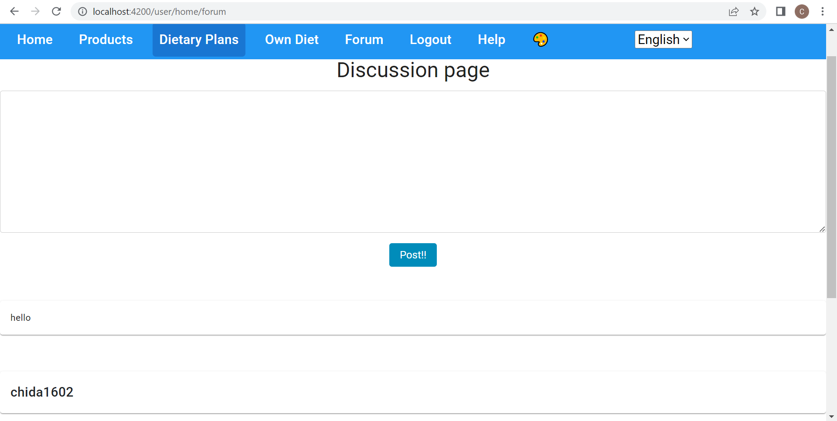
Userside forum page
The forum is a discussion page where admin and users can interact
here a user can post his query or feedback or suggestion so that admin can reply to that

Slide 13
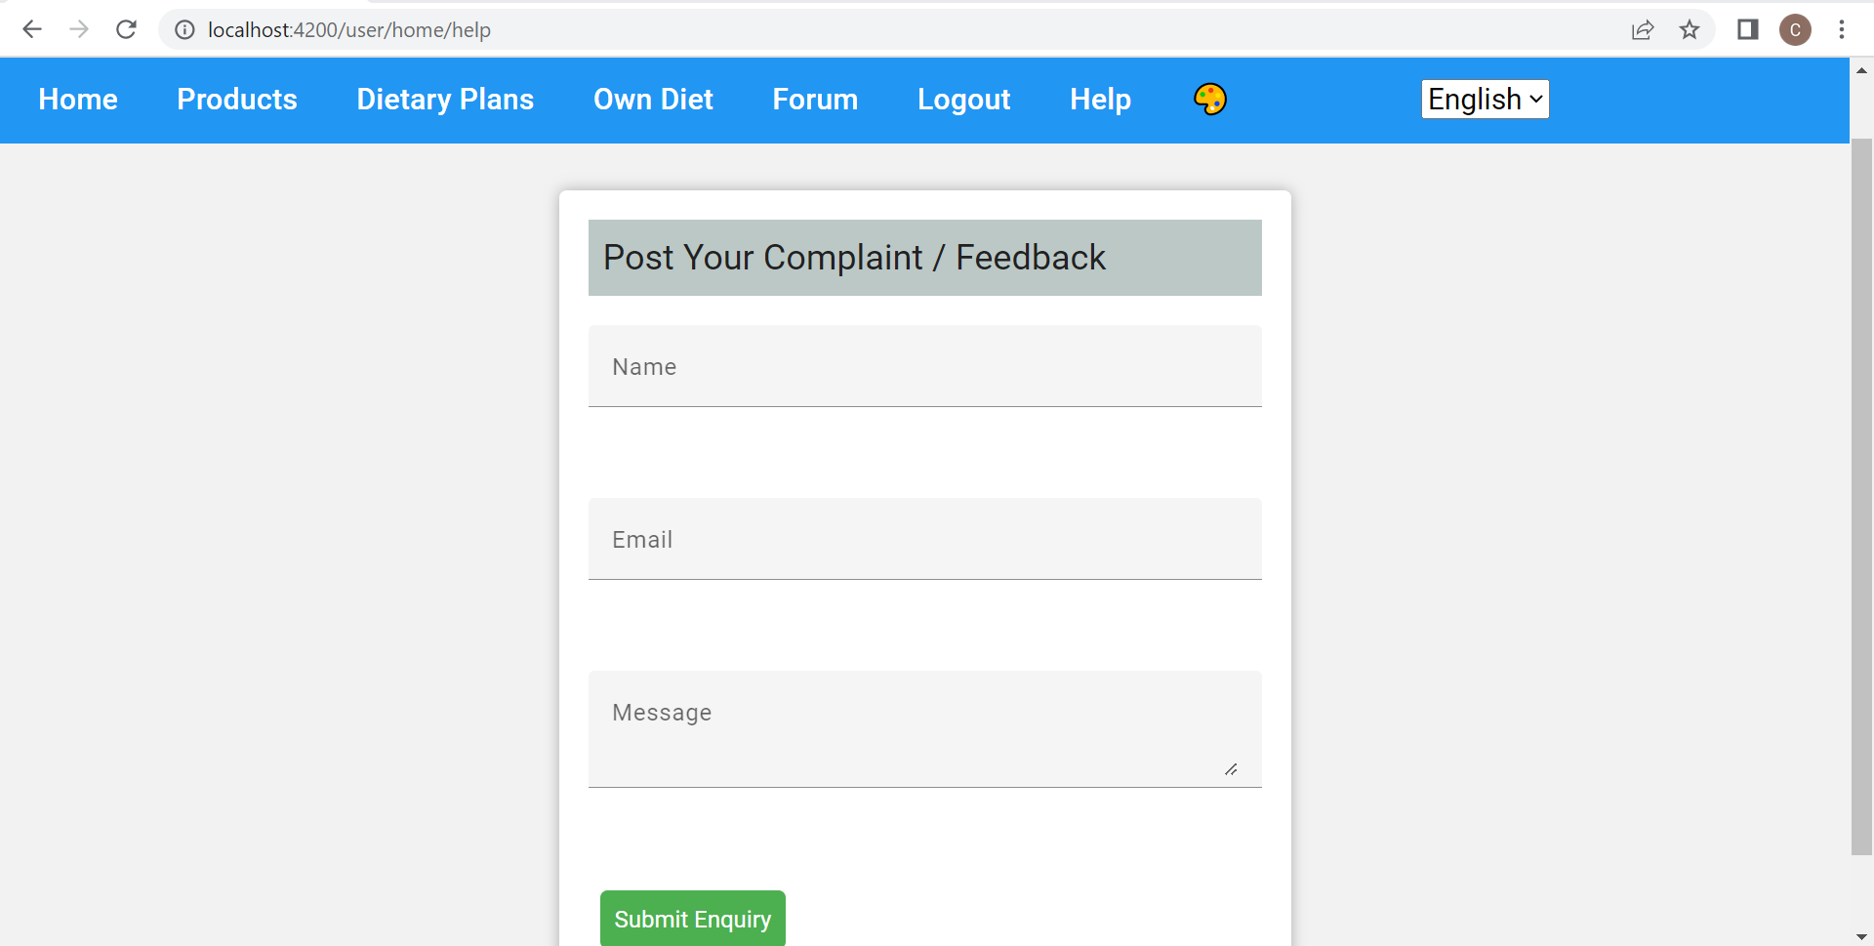
Userside complaints page
On clicking on help it takes to complaints page
here we can post our complaints queries and feedbacks to the website which can be seen by admin

Slide 14
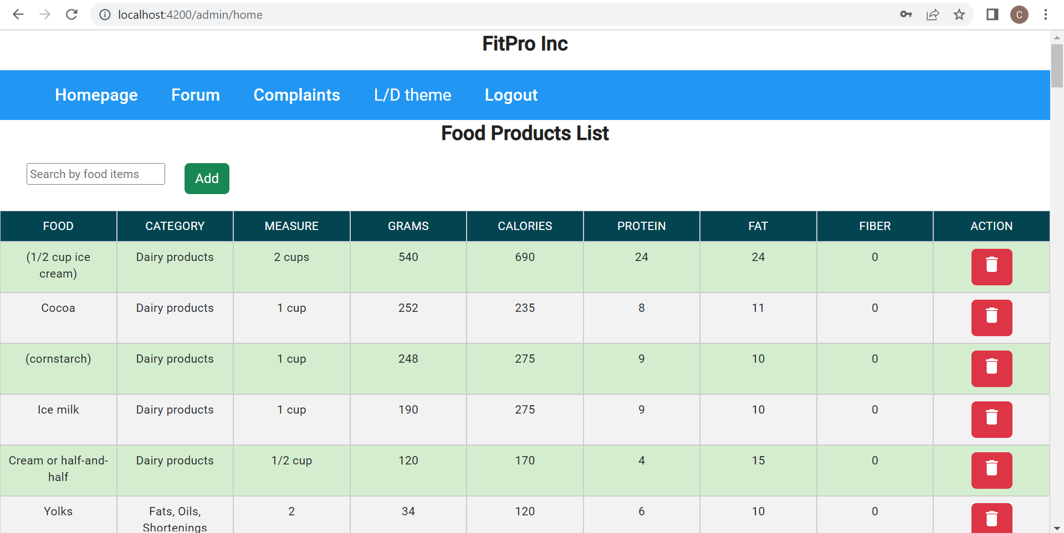
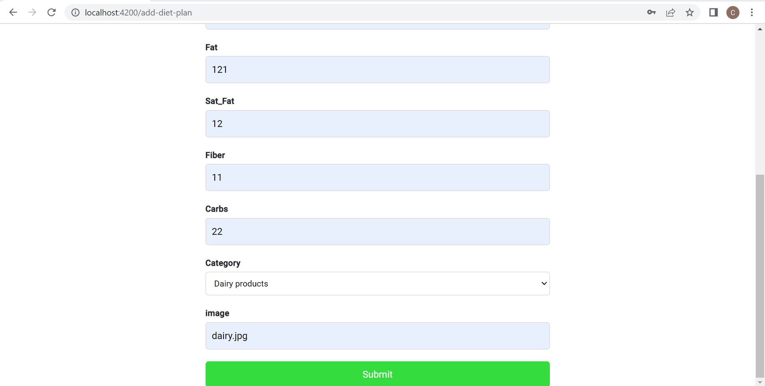
Admin homepage
After logging as admin with admin credentials takes to a home page where all food products is displayed in a table
here admin can add and delete the products

Slide 15
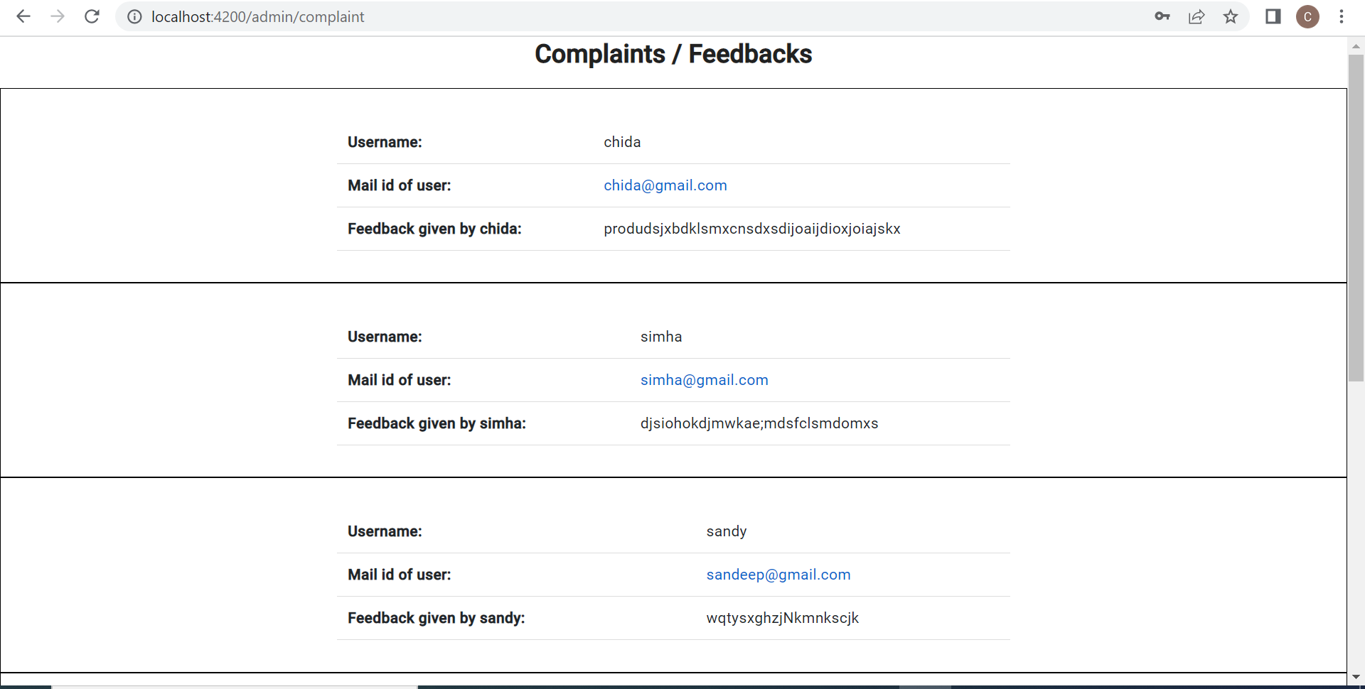
Admin complaints
In admin side menu bar consists of complaints on clicking it takes to a page where complaints and feedbacks were displayed which was posted by user
here admin can read the complaints and reply to the user mail

Slide 16
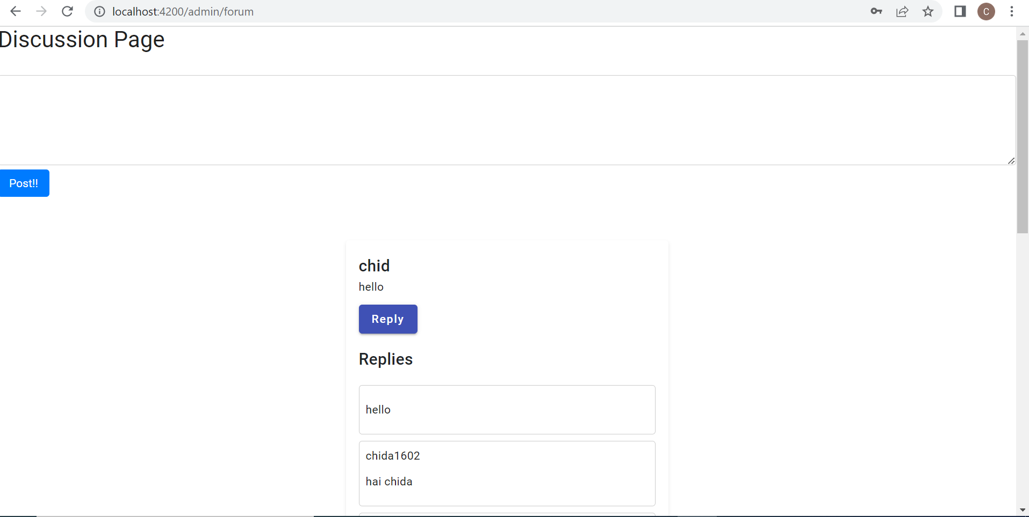
Admin side forum page
it is a discussion page where admin also can post whatever he want
admin also can reply to the users comments

Slide 17
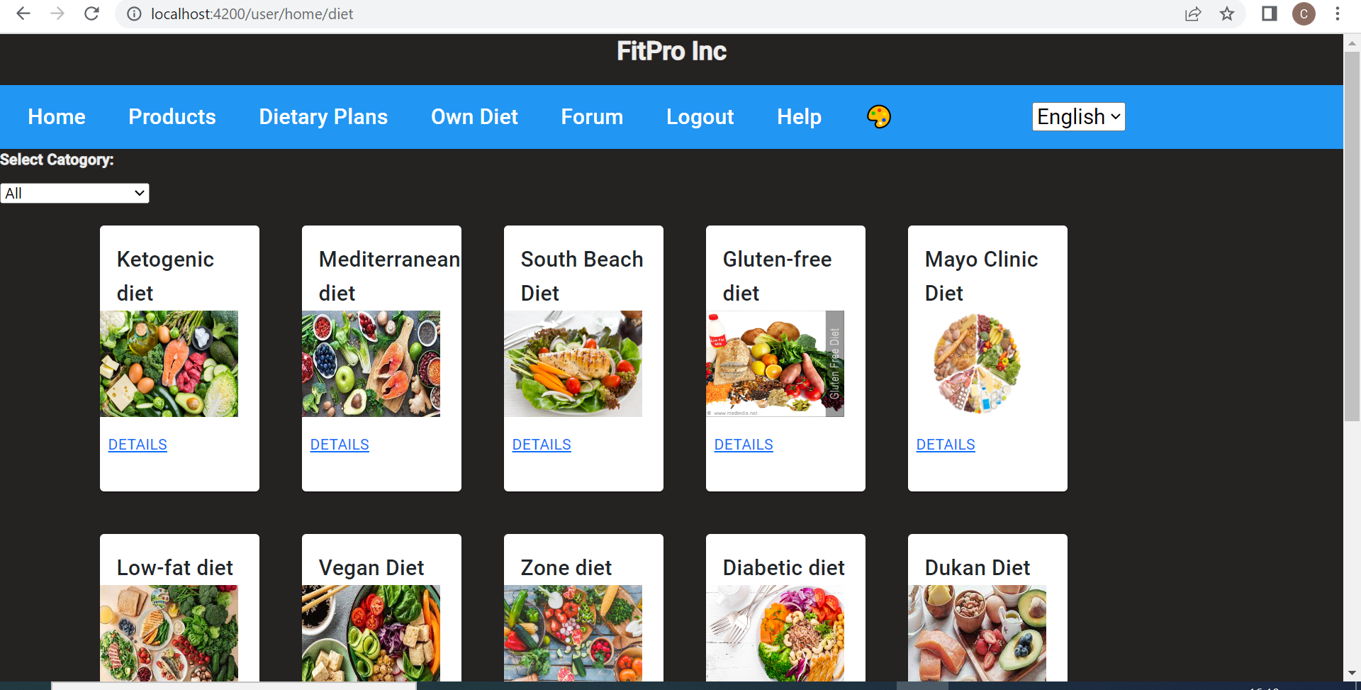
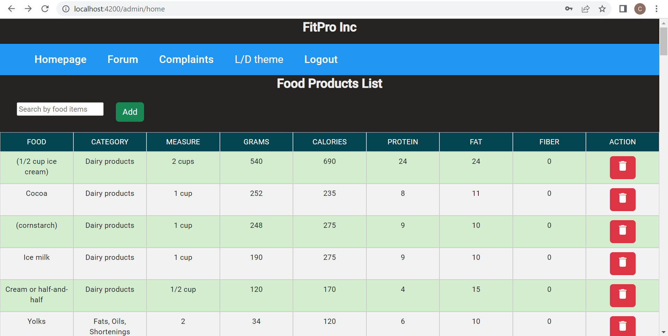
Light/dark theme
In both admin and user side we can change the dark theme to light theme
and from light theme to dark theme

Slide 18
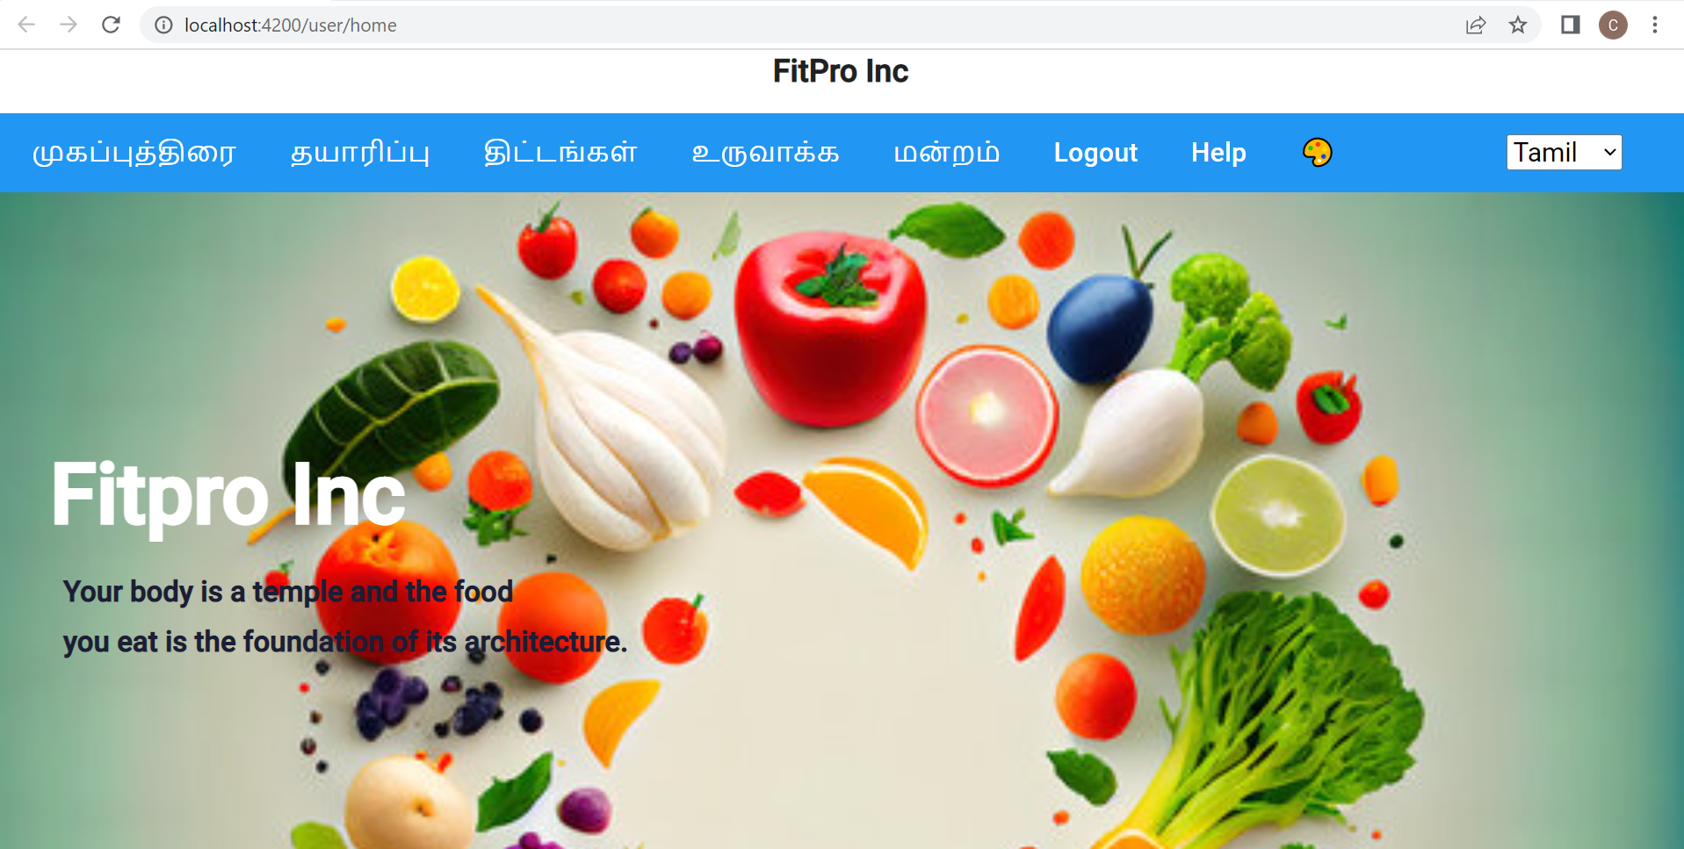
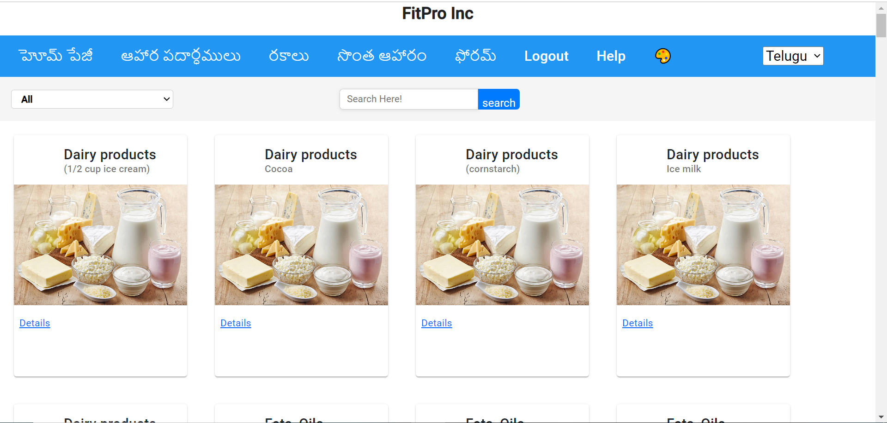
Internationalisation
User side user side I have implemented internationalization using ngx translation
there is a option that menu bar can be displayed in Telugu Hindi English and Tamil languages

Slide 19
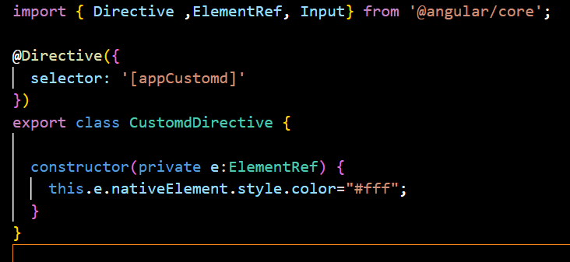
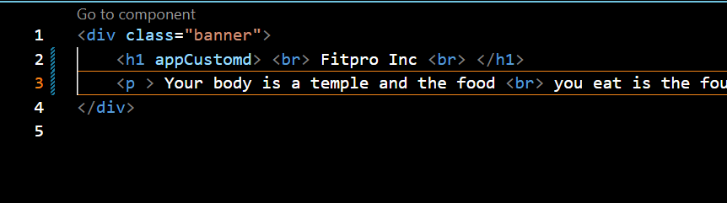
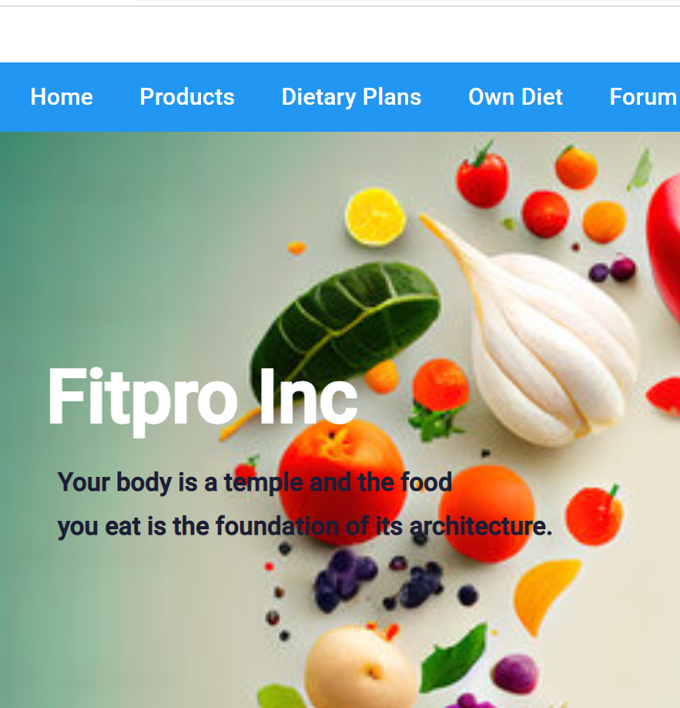
Custom directives
directive is created named as customd
in that customd Directive.ts I have written a function for styling an element
In user home html I have implemented H1 tag . in H1 tag I have used app custom
Here we can see that fit Pro is displayed in white colour using custom directive method

Slide 20
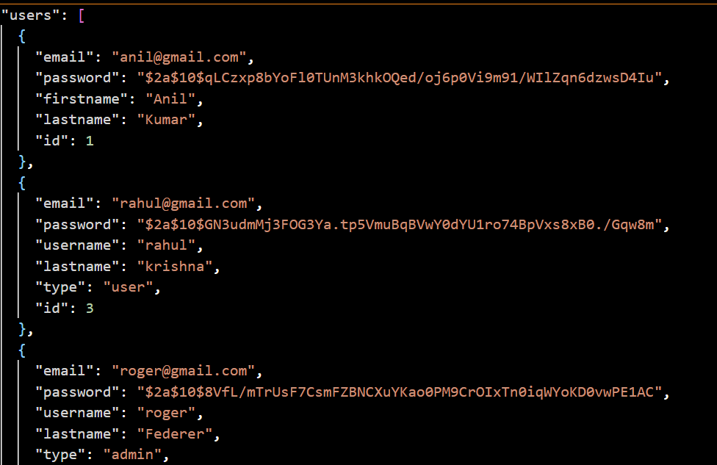
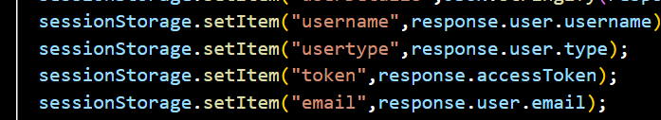
Security Implementation
We have used the session storage for storing the registration credential details
Here in the login component.ts we have used session storage for registration credentials
Here the credentials like password is saved in json as token-based as shown in above picture

